Slide 1
Interface (API) Design
Architect’s Perspective

Slide 2
What is an API?
Exposes the public facing functionality of a software component
  Operations, inputs, and outputs
Exposes functionality independent of implementation
Internal components and services and public external facing frameworks and services
Proxy for remote call invocation protocols (e.g., Java RMI, SOAP or REST)
  XML, JSON message encoding

Slide 3
Why is API Design Important?
Enable support of QA’s (e.g., modifiability, interoperability)
Internal APIs enable successful development and support
Successful public APIs capture customers …
But poor API’s can become a liability
  Customers invest heavily: developing, learning, using
  Cost to stop using an API can be prohibitive
Public APIs are forever - one chance to get it right
  “The first version of an API is always easy”

Slide 4
Conway’s Law
Programmer Melvin Conway in 1968 …
“organizations which design systems ... are constrained to produce designs which are copies of the communication structures of these organizations”
For two software modules to interface properly, developers of each module must communicate
Therefore a system’s interface (architecture) structure will reflect its social organization

Slide 5
The Cost of Poor APIs
Longer development times
  Harder to understand during design
  Difficult to program, may require extra code
    Program size, complexity, and efficiency
  Complex code implies more testing with greater bug risk
Hierarchies of layered APIs compound the costs
  Defect amplification - defects in lower layers propagate upward with greater impact
    E.g., security holes in low level c library string manipulation APIs
  Adding wrappers hide but don’t fix a bad API

Slide 6
Why is API Design Important to an Architect?
APIs are one of an architecture’s most tangible and useful outcomes
Every architecturally significant module will have an associated interface
Good interface design helps realize architecture objectives during construction
  The architect should oversee (do) interface design
  The architect should dictate API style and policy – e.g., naming
Useful modules tend to get reused
  Good reusable modules are business assets – frameworks

Slide 7
API “Quality Attributes”
Usability (“DevX”)
  Satisfies requirements (of course)
  Learnability
  Productivity - easy to use, even without documentation
  Understandability
    Hard to misuse
    Easy to read and maintain code that uses it
  Simple, consistent

Slide 8
API “Quality Attributes” (cont)
Expressiveness – abstraction matches developer’s mental model
Extensibility - stable but easy to extend for new versions as necessary
Performance – speed and resource consumption
Robustness and security

Slide 9
The Process Of API Design
Preamble - system requirements and software architecture identify components of interest
For an API instance - write a short specification, prototype, evaluate, refine
Write to the API early and often
  Expect defects and changes to evolve the API
  The client code artifacts live on as examples and unit tests

Slide 10
API Evaluation Analogous to HCI Evaluation
Experts using heuristics
“Users” do cognitive walkthroughs
“User” testing – given tasks programmers write against the API’s

Slide 11
API Heuristic Evaluation
Heuristic | Measurement
Visibility of status | Check system state
Match to real world | Meaningful naming
User control and freedom | Abort or reset operations
Consistency | E.g., Parameter order
Error prevention | E.g., default parameters do the right thing
Recognition over recall | Naming again
Flexibility and efficiency of use | Programmability
Aesthetic and minimalist design | Good naming
Error recognition and recovery | Helpful error returns/exceptions
Help and documentation | Available and accurate

Slide 12
API Design Guidelines
Cohesion | Do one thing well
Abstraction | Hide the implementation
Information hiding | Hide data and operations
Good naming | Self explanatory, consistent, metaphoric
Consider performance implications | Avoid excessive memory allocation, unnecessary computation
Minimize interface signature “surface area” | Fewer types, functions, parameters; “if in doubt, leave it out”
Good “ergonomics” (the “API feel”) | Consistent style for naming, parameter typing and order, error handling, calling order, etc. Follow platform conventions, establish a guide
Take the client’s perspective | Sufficient functionality, testability consideration
Support usage (use case) policy (degree of client coupling) | General purpose – “policy free”, flexible; special purpose – “policy rich”
Document | Involve users to avoid developer bias, include exception handling, unit tests, self documenting?

Slide 13
API Contracts
“Classes of a system communicate with one another on the basis of precisely defined benefits and obligations” [Bertrand Meyer, CACM, Vol 36, No 9, 1993]
Correctness - formal, precise and verifiable interface specifications – “the contract”
  Pre-condition – always True before an interface is invoked; client responsibility
  Post-condition – always True once a component successfully completes it's assigned task; supplier responsibility
  Invariant - conditions held True following each successful completion (or exception – contract not fulfilled); e.g., range of valid variable values
Performance – fast, usually fast, variable but predictable, variable and unpredictable
“The API Performance Contract”, Sproull, Waldo, CACM, 3/14

Slide 14
Documenting Interfaces: Interface Specification Template
Interface identity (name, version)
Responsibilities (services, functions) provided (*IDL option)
  Signature syntax (arguments, types, etc.)
  Semantics – usage scenarios
    Pre/post conditions, return values
    Cross function coordination
    Usage restrictions (initialization, timing of use, ownership, etc.)
Data type definitions – application specific
Exception definitions and handling
*IDL – Interface Description Language – self descriptive, language independent, human and machine readable

Slide 15
Documenting Interfaces: Interface
Specification Template (cont)
Variability provided by the interface
  such as configuration, performance ranges, data capacity ranges
Quality attributes of the interface, e.g., performance considerations
Resource requirements (resources required, dependencies)
Rationale / design issues and resolution

Slide 16
Specification Example
Interface Identity | userCreate
Responsibility | userCreate(firstName, lastName, type, email, password) {...}
Data Type Definitions | String firstName; String lastName; String type; // default = “member”, other = “leader”, “admin” String email; String password; int id = uniqid(); // a unique identification number
Exception Definitions and Handling | UserAlreadyExistsException - thrown when the system attempts to create a user that already has the specified firstName & lastName or email. When thrown, the user is redirected to the Create User page. UserNotAuthorizedException - thrown when an unauthorized user tries to create a new user. When thrown, the user is redirected to the Create User page and an administrator is notified of this action.

Slide 17
Specification Example
Interface Identity | Shopping Cart
Responsibility | Add Item to cart ● URL ○ /account/addItemToCart ● POST ○ Input ■ Item: JSON ItemObject ○ Output ■ The server adds the item to the user’s cart ■ A status message and code is returned back
Data Type Definitions | In JSON format: Name - Name of the object Rating - Rating of the object Description - Description of the object Array of {Vendor, Price, Link} - Vendor - A vendor selling the object; Price - The price for the vendor; Link - A link to the vendors store with the object
Exception Definitions and Handling | The server will return back JSON output with an error code as well as a message describing what the issue was

Slide 18
What is in use today?
Google: 5 billion API calls/day (April 2010)*
Facebook: 5 billion API calls/day (October 2009)*
Twitter: 3 billion API calls/day, 75% of all traffic (April 2010)*
Netflix: 20 billion API calls/month (January 2011)**
eBay: 9 billion API calls/month (November 2009)***
Bing: 3 billion API calls/month (March 2009)*
NPR: 1.1 billion API-delivered stories/month (March 2010)*
Amazon: over 100 billion objects stored in S3 (March 2010)*

Slide 19
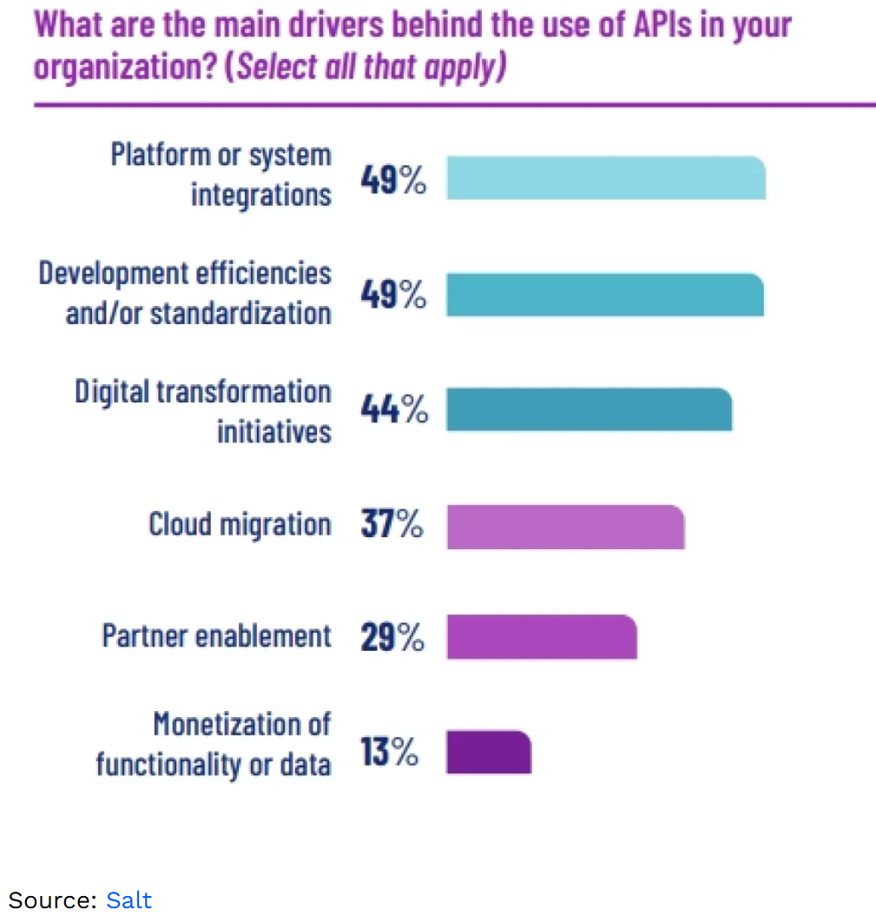
General API statistics
The fastest-growing type of data in 2021 was API data which grew by more than 20%. ( Cloudflare)
POST method is the most common method used in APIs, with more than 50%, followed by GET method, with almost 45%. (Cloudflare)
The market capitalization of companies that have adopted APIs has grown by more than 12% compared to those that have not adopted APIs. (Forbes)

Slide 20
Just the facts …
Over 90% Of Developers Use APIs
Developers Spend 30% of Their Time Coding APIs
This is almost double the second most time-consuming task, manually debugging code, which clocks in at 17%.
Travel Data Is a Top Integration Need
Open Banking to Have 130 Million Users by 2024
Healthcare APIs Are Growing By 6.3% CAGR
83% of All Internet Traffic Belongs to API-Based Services
93.4% of API Developers Are Still Using REST

Slide 21
More facts …
API statistics in industries
Finance
More than 1 billion API calls were made in May 2022 to open banking APIs. (Open Banking)
The number of API calls made by the financial sector experienced a 125% growth in 2020. (Google Cloud)
The number of APIs deployed in the banking sector is anticipated to increase by 100% from 2022 to 2027. (McKinsey)
48% of FinTech companies indicate API security as a top concern in API utilization. (FinTech Future)
Retail
The retail and travel industry had the most API calls made in 2020, with 34%. (Google Cloud)
More than 50% of retailers have indicated that APIs accelerate innovation, and 36% indicated that APIs are a strategic asset that can create business value. (Google Cloud)

Slide 22
A hackathon view …
Communications APIs
Twilio (SMS, Messaging, Voice)
Social APIs
Facebook
Payments APIs
Despite some concerns over its security, Venmo
Geo APIs
Unsurprisingly, Google
Music APIs
Spotify

Slide 23
440 Hackathon
So, APIs are a ‘must’ for SW Engineering … let’s try them out
GitHub - public-api-lists/public-api-lists: A collective list of free APIs for use in software and web development 🚀
Pick a public API (w/o auth)
How fast can you implement it?
- 15 minutes: Starts … now
- Demo to the class

Slide 24
Commercial APIs: Assignment
https://mycourses.rit.edu/d2l/le/content/983442/viewContent/8304550/View
Pick one of the following API’s :
  Web App – Mailchimp: http://developer.mailchimp.com/documentation/mailchimp/reference/overview/
  Drone control - DroneKit-Python API Reference (dronekit-python.readthedocs.io)
  Gitlab - https://docs.gitlab.com/ee/api/api_resources.html
  Crypto++: Crypto++ Library 8.6 API Reference (cryptopp.com)
Browse to form learnability first impressions
Evaluate the details of a few specific API’s from a developers perspective
  Understandable?
  Simple to use?
  Limitations or other concerns?
  Cohesion/coupling?

Slide 25
References
“How to Design a Good API and Why it Matters”, Joshua Bloch, Google
“API Design Matters” Michi Henning, CACM May 2009
“Practical API Design: Confessions of a Java Framework Architect”, Jaroslav Tulach, Books 24x7
“Improving API Usability”, Myers Stylos, CACM May 2016

